Slide 1

About the Scheme
MSME guidelines as per Office Memorandum Dt. 24.05.2022 No.1(1247)/CDD/EFC/MSE-CDP/2021E
Implementing agency for Setting Up CFC – Ministry of MSME, govt of India
Key Objectives:
To enhance sustainability, competitiveness and growth of MSEs
To Build capacity of MSEs for common supportive action through integration of self-help groups, consortia, district industry associations etc.
To set up common facility centers in industrial areas
Promotion of green and sustainable manufacturing technology for clusters.
The cluster can get a grant of upto Rs. 20 crores which is not to be returned to government and no interest shall be charged on this amount. This is subject to cluster meeting all the requirements of the government guidelines for CFC-CDP scheme.

Slide 2
CFC Concept
Common Facility Center has to be different entity from existing beneficiaries
Because of CFC facilities each participating MSE shall be benefitted in terms of increased business / reduced cost / better quality
Existing business of none of the participating MSE shall be closed/ decreased because of CFC facility
It shall create enhancement of Make in India, more MSEs participating and yielding better quality products at low cost
It shall enhance competitiveness of participating MSEs due to technology upgradation

Slide 3
CFC Concept ….
Expected 20 -25 shareholders and 25-30 beneficiaries (excluding shareholders)
Shareholders shall not be from same family / in blood relation to each other
Maximum share 10% by a single shareholder
Can be upto 8 shareholders having 10% share and remaining with 0.50- 1.00 % share holding to make a total of 20-25 shareholders
Land shall not be owned personally by any shareholders, but by the cluster
In case of rented premises, land / facility not owned by any family member of any of the share holder

Slide 4
CFC Concept ….
Shareholders to be manufacturers of input or output product, Udyam registration must be as ‘Manufacturer’
All shareholders and other beneficiaries to have manufacturing facilities within 30km radius circle
CFC place (has to be nearby within 30km radius circle) and has to be identified before preparation of concept note
CFC place can be owned by CFC unit or on rented with lease agreement of at least 15 years
Current manufacturing processes and future scenario (after CFC formation) must be defined including benefits after CFC formation

Slide 5
Cluster Formation – Do’s and Don’ts
Decide CFC location and shareholders as well as beneficiaries within 30km radius circle
Each shareholder facility shall have working machines for manufacturing
Beneficiary can be direct product / component / material manufacturer / supporting manufacturing (e.g. packing materials etc.) or can include few service providers who can be benefited
Current and Future process flow for each unit shall be defined and indicate benefits from future flow
Each participating MSE (either shareholder or beneficiary) should be aware of CFC formation and his/her expected benefits

Slide 6
Cluster Formation – Do’s and Don’ts ….
Product range to be covered by CFC benefit shall include similar products e.g. Eyewear of Acetate / Injection moulded / Metallic / 3-D printed can be considered similar range
It shall have positive impact on business volumes of any participating MSE
It shall not have negative impact on environment and/or safety of personnel working in CFC and/or any beneficiary MSE
Systematic working of MSEs is expected and same to be demonstrated to MSME Officials during visit
All facilities / machines at participating MSEs to be working , CFC land & Building will be mortgaged to Govt. for at least 15 years (if owned by CFC Cluster)

Slide 7
Benefits of CFC Project Implementation
Cost of production for each participating MSEs shall be reduced in one or other process
Ease of availability of facilities for which participating MSE is dependent on outside / long distant source
Quality will improve due to technology advancement
Overall performance will improve due to systems implemented in line with ZED and ISO standards
3rd party recognition such as ZED and ISO certification can help obtaining more new clients
Every share holder will earn from profit of CFC
⁠The product range for supplying products to market can increase
All shareholders and beneficiaries shall be guided to enhance their production/ quality & sales at national and international levels

Slide 8
Monetary Benefits of CFC Project Implementation
ZED and ISO certifications for all participating MSEs without any handholding fees by cluster members (GST on payments to QCI and certifying body to be borne by MSME or by Cluster Head)
3 ZED Certifications (Bronze, Silver and Gold) possible as per capability of each MSME unit
3 ISO certifications (ISO 9001, ISO 14001 and ISO 45001) possible as per capability of each MSME unit
Shareholders to earn profits from sharing facilities of CFC (where feasible) to all participating MSEs and MSMEs apart from those participating

Slide 9
Benefits of ZED Certification
Business loans at reduced rate of interest (0.25-1.00 % reduction in rate of interest possible depending on your bank / financial institute)
If ISO certification benefits (1 ISO certification per ZED certification) is not availed re-imbursement of upto Rs.50,000/- possible on product testing / certification
3rd party recognition leading to priority in supplies to Govt. sector and other GeM portal supplies
Technology intervention benefit of upto Rs.3,00,000/- for each ZED Silver / Gold certified MSME (through BMCPL handholding) for new machines etc.
Due to on-going training awareness of personnel working in organization improves

Slide 10
Benefits of ISO Certification
ISO 9001 – Quality Management – ensures consistent quality at controlled / reduced cost of operation
ISO 14001 – Environmental Management – ensures legal environmental compliances and no adverse impact on environment
ISO 45001 – Occupational Health & safety Management – ensures no adverse impact on employee & customer safety as well as health
Overall – Little investment at beginning brings in long term benefits
System for monitoring organizational performance is developed – Unit Head becomes free from day-to-day operations and is able to devote time for business development activities
⁠Better reputation among customers leading to higher sales

Slide 11
CFC Actions and Timeline
Sr. No. | Timeline (Month wise) | Actions
1 | M1-M3 | -Collection of Udyam Aadhaar Cards of at least 25 share holders. Initiate the collection of Udyam Aadhaar Cards for another 20 to 25 beneficiaries and complete it asap. -Improvement of Existing processes and documentation at current units of Shareholders and Beneficiaries and achieving Maximum possible ISO and ZED certifications ( Preferably above 75% of share holders and beneficiaries) for improving cluster's score and rating to ensure eligibility and to get the maximum grant amount -Preparation of Manufacturing Process flow (Current and after CFC machines)
2 | M4 | Preparation of Concept Note and submitting it to Government and if Government suggests any changes then incorporate them
3 | M5 | Formation of Section 8 Company

Slide 12
CFC Actions and Timeline
Sr. No. | Timeline | Actions
4 | M6 | Preparation of DPR
5 | M7 | Approval of DPR from Government
6 | M8 | Receiving technical report from Technical Institute
7 | M9 | Receiving Evaluation Report
8 | M10 | State Validation Meeting (Depending upon date of meeting fixed by Government) On-line application and State compliances
9 | M11 | Centre Meeting ( Depending Upon Date of meeting fixed by Centre)
10 | M12 | Receiving final approval

Slide 13
Expectations from CFC Promoters
Make aware all participating MSEs (Shareholders as well as beneficiaries) about CFC concept and benefits
Ensure that cleanliness and safety (as per guidance given by ZED / ISO consultant) is maintained in all units
Unit name and work area names to be displayed with permanent boards (Flex boards acceptable)
Fire extinguishers, First Aid box and Personal Protective Equipment (as per guidance given by ZED/ISO consultant) are made available
After each visit of consultant go through report and suggest if any action is required
Participate in monthly meeting with AMSPL team for review and actions

Slide 14
Initial Actions for Timely submission of Concept Note
Finalize MSME names (their Unit Heads, products / processes, locations) with Udyam certification
Clearly identify Shareholders and beneficiaries
Convince participating MSMEs through one-to-one meetings, initial ZED Bronze certification etc – Gear them up for first visit of MSME officials

Slide 15
Benefits of Management Systems Implementation / Certification
(ISO 9001 QMS, ISO 14001 EMS and ISO 45001 OHSMS)

Slide 16
ISO 9001:2015 QMS Benefits
Ability to consistently provide products and services that meet customer and applicable statutory and regulatory requirements
Facilitating opportunities to enhance customer satisfaction
Addressing risks and opportunities associated with its context and objectives
Ability to demonstrate conformity to specified quality management system requirements
Improve organizational performance
Reduce cost of poor performance – leading to improved profitability

Slide 17
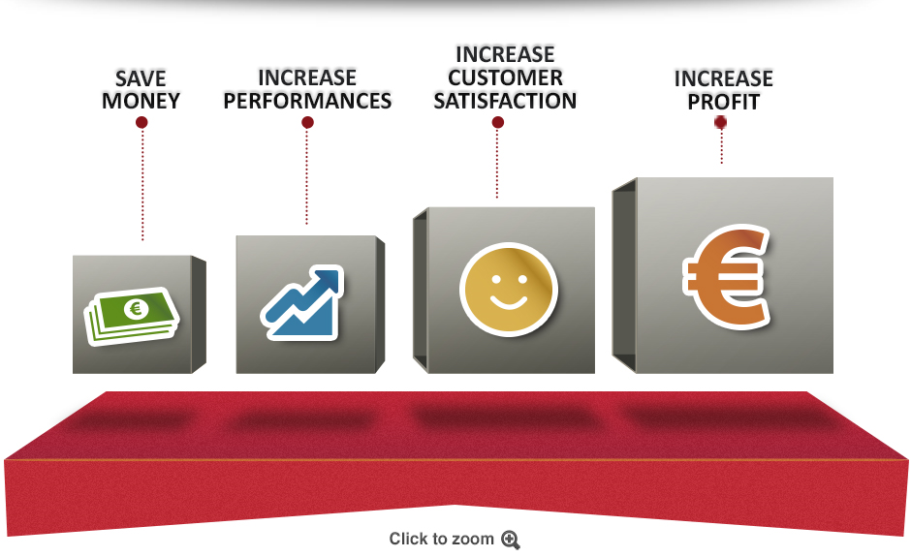
Expected Benefits of ISO 9001:2015 QMS
(If QMS is implemented properly and followed by client)

Slide 18
ISO 14001:2015 EMS Benefits
Manage environmental aspects / impacts of the organization – how and how much pollution is happening and how to reduce / control
Improve environmental performance of the organization – energy saving, optimum use of resources, reduced impact on nearby industries / residential areas
Fulfill Compliance Obligations – proper waste management, no violation of environmental rules/ regulation
Achieve Environmental Objectives – energy cost per unit production, no bad effect on health due to pollution, ambient air quality, outgoing water quality
Cost reduction due to reduced waste, optimum utilization of resources, no penalties as no legal violations….

Slide 19


Expected Benefits of ISO 14001:2015 EMS
(if EMS is properly implemented – Not contributing global warming, contributing in better environment)

Slide 20
ISO 45001:2018 OHSMS Benefits
Manage OH&S hazards / risks of the organizational activities – necessary PPE and controls available to avoid risk incident happening
Improve OH&S performance of the organization – moving towards zero incident / accident – improves employee morale and hence productivity
Prevent injury and ill health to workers – everyone aware of prevention mechanism – people can concentrate on work increasing organizational efficiency
Provide safe and healthy workplace – Can prevent employee turnover and create feeling of belongingness

Slide 21
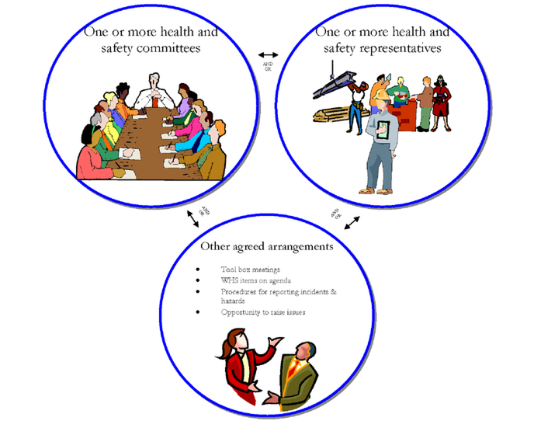
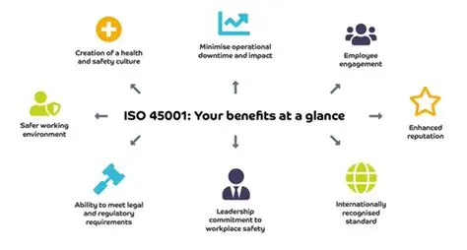
Expected Benefits of ISO 45001:2018 OHSMS – Improved Participation

